Slide 1
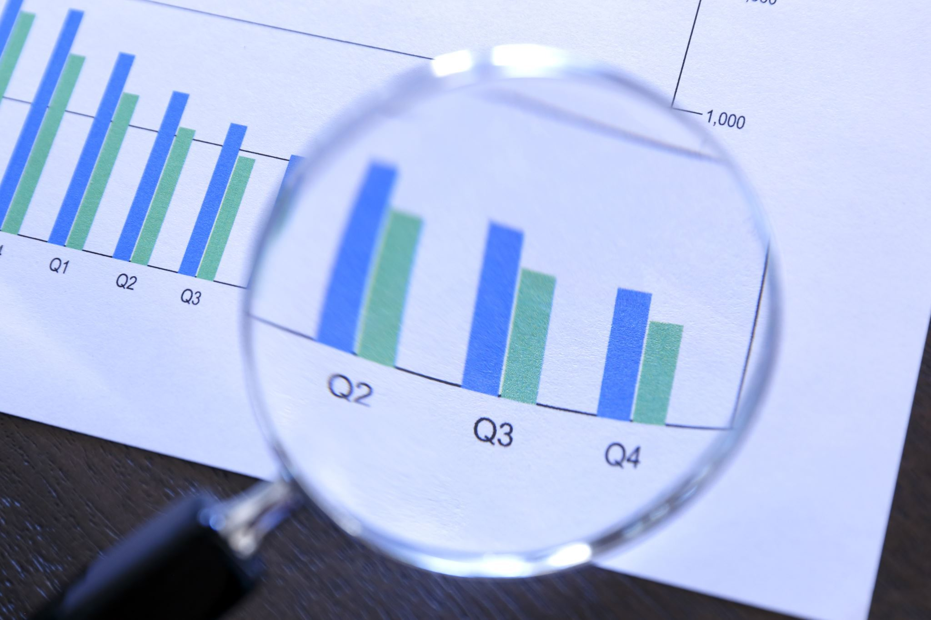
The Impact of Economic Indicators on National Income
Research Objectives:
To investigate GDP, GDP growth, foreign investment, inflation rates, and government expenditure across different countries over the last three years.
To analyze and summarize how these economic indicators relate to national income levels.
To create machine learning models that can reliably predict if a country is categorized as having a high-income status.
To assess and compare the efficiency of various machine learning algorithms in forecasting high-income classifications.
Notes:
This study employs advanced machine learning methodologies to investigate the predictive relationships between key economic variables and high-income country classification.

Slide 2

Data Collection Process
Data sourced from the World Data Bank.
Includes information covering the years 2021 to 2023.
The World Bank is dedicated to maintaining data quality, as detailed in their framework for evaluating national statistical systems and enhancing data sharing.
Notes:
- The data used in this analysis follows internationally recognized standards, methodologies, sources, and classifications, ensuring its reliability.
- It is noteworthy that this period follows the pandemic era, during which the global economy was in the process of recovery.

Slide 3

Data Preprocessing Techniques
Raw data cleaning using Python libraries.
Utilizes Pandas and NumPy for data manipulation.
Ensures data quality and consistency.
Prepares data for further analysis.
Notes:
Columns with 25% or more missing data were dropped.
- Missing values have been imputed using KNN Imputer (calculates the distance between the point with missing value and all other Points - identifies the 𝑘 closest data points - imputes the missing value using the mean or median of neighbors).
Using a heatmap, fields with high correlations have been removed.
Outliers have been removed.
Data has been standardized using a standard scaler, a tool that centers data around the mean and scales it to unit variance.

Slide 4
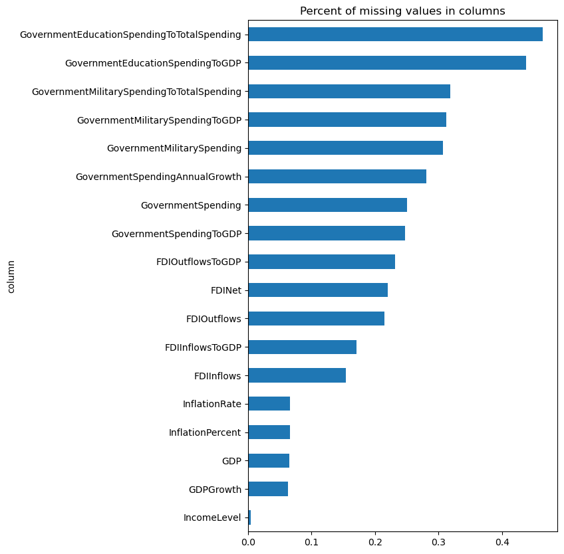
Major Data Challenge: Missing Data
Notes:
One of the significant challenges we faced with our dataset was the presence of numerous missing data points. This issue rendered several fields unusable.

Slide 5
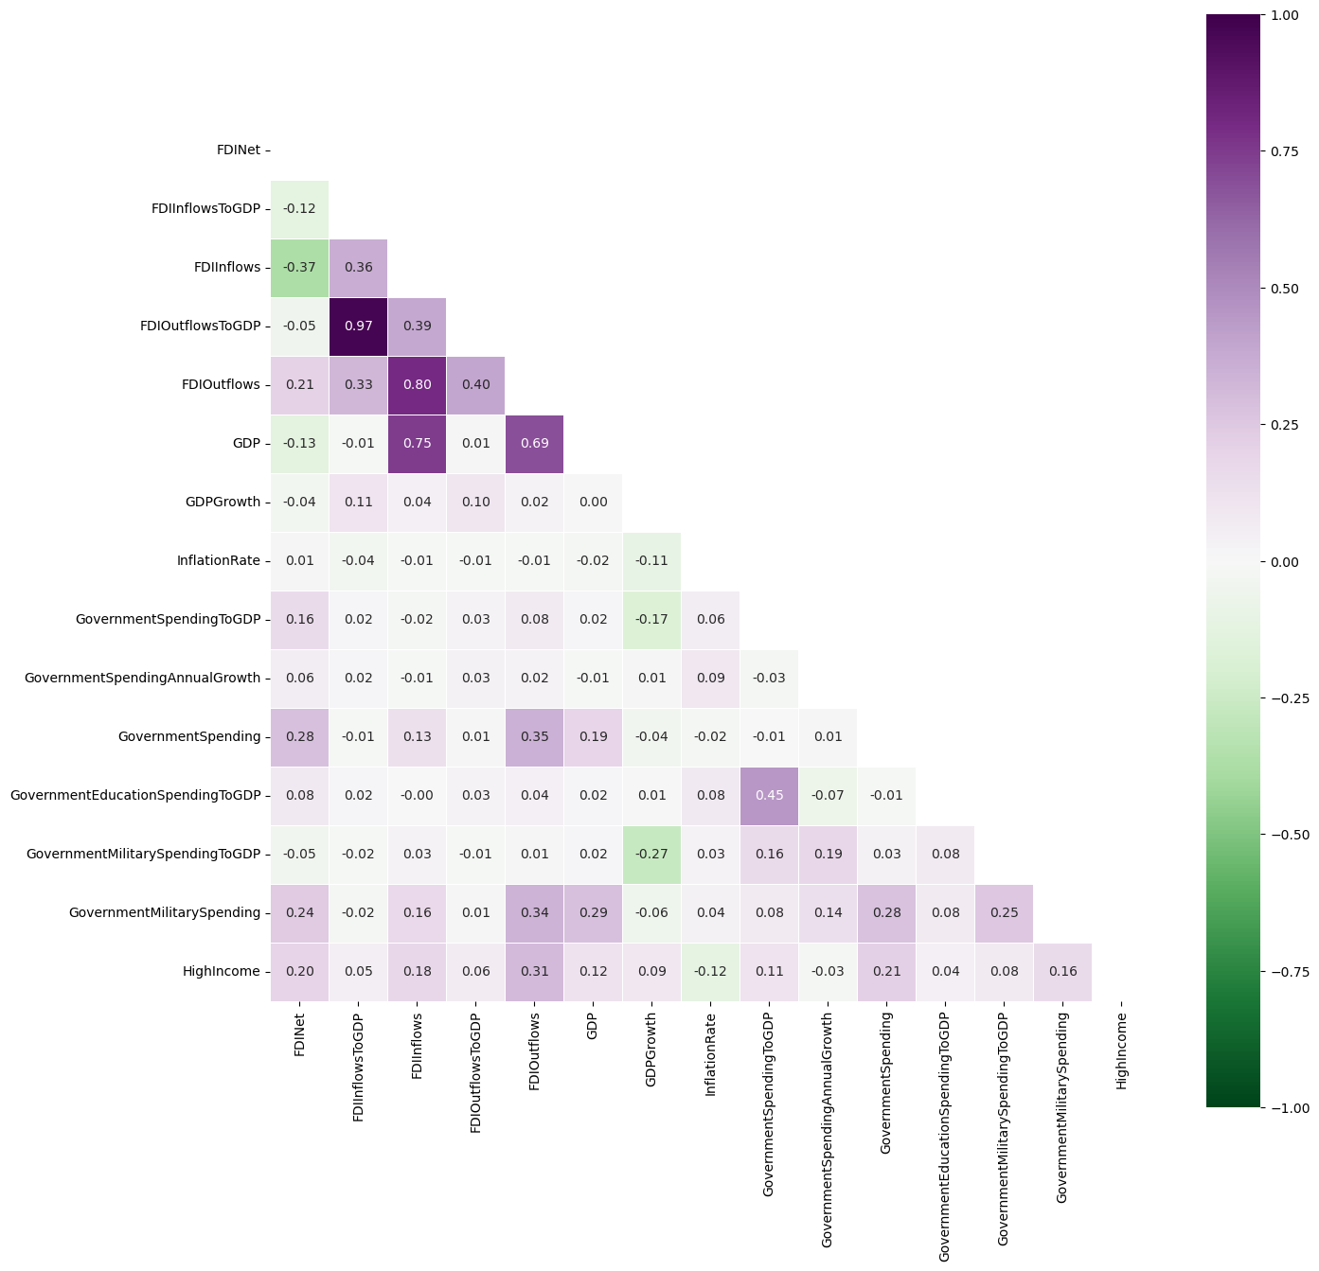
Economic Indicators
Notes:
In this heatmap we can see correlation matrix between all remaining fields and the available indicators that we are analyzing after data cleaning.

Slide 6
Exploratory Data Analysis (EDA)
Descriptive analytics to explore data trends.
Visualizations include histograms and scatter plots.
Visualizations include histograms and scatter plots.
Focus on understanding distributions across countries.
Notes:
We begin by conducting an exploratory analysis of our data to gain an understanding of its characteristics.

Slide 7
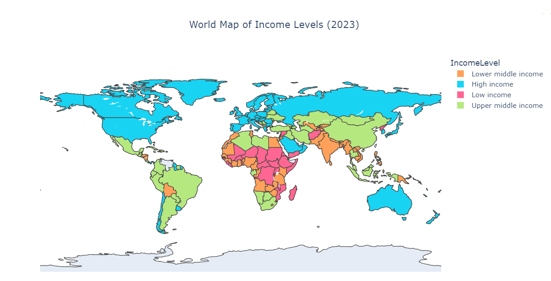
Notes:
What countries have higher income levels?

Slide 8
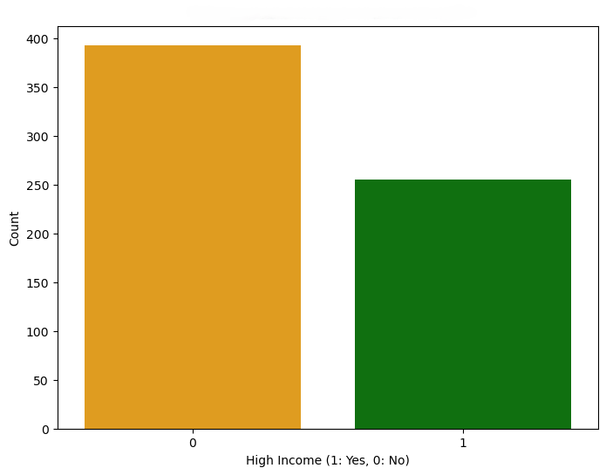
High Income Countries
American Samoa | Andorra | Antigua and Barbuda | Aruba
Australia | Austria | Bahamas | Bahrain
Barbados | Belgium | Bermuda | British Virgin Islands
Brunei Darussalam | Bulgaria | Canada | Cayman Islands
Channel Islands | Chile | Croatia | Curaçao
Cyprus | Czechia | Denmark | Estonia
Faroe Islands | Finland | France | French Polynesia
Germany | Gibraltar | Greece | Greenland
Guam | Guyana | Hong Kong | Hungary
Iceland | Ireland | Isle of Man | Israel
Italy | Japan | Korea | Kuwait
Latvia | Liechtenstein | Lithuania | Luxembourg
Macao | Malta | Monaco | Nauru
Netherlands | New Caledonia | New Zealand | Northern Mariana Islands
Norway | Oman | Palau | Panama
Poland | Portugal | Puerto Rico | Qatar
Romania | Russian Federation | San Marino | Saudi Arabia
Seychelles | Singapore | Sint Maarten (Dutch part) | Slovak Republic
Slovenia | Spain | St. Kitts and Nevis | St. Martin (French part)
Sweden | Switzerland | Trinidad and Tobago | Turks and Caicos Islands
United Arab Emirates | United Kingdom | United States | Uruguay
Notes:
A significant number of countries have high incomes.

Slide 9
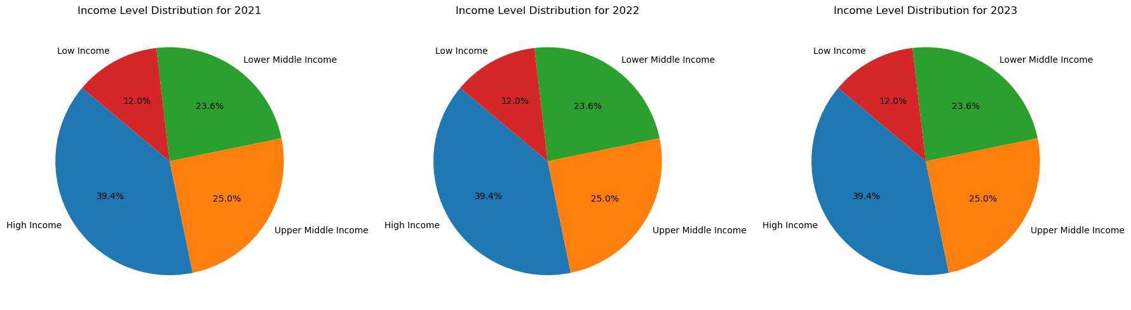
Changes in Income Level Distribution
Notes:
Were there any changes in income level distributions between the years 2021 and 2023? Not at all. It seems like this metric is very consistent.

Slide 10
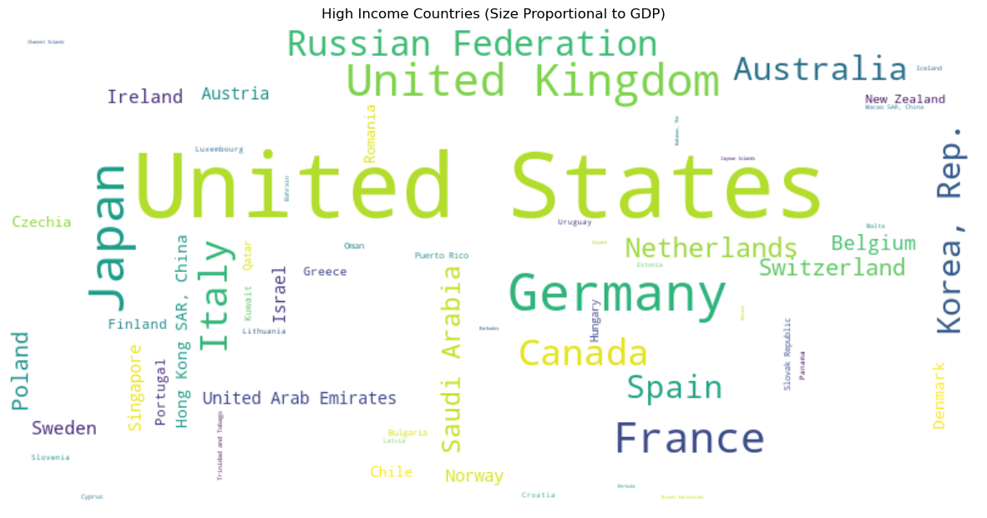
Notes:
How do economic indicators, such as GDP, influence national income levels? This is the central question we aim to address in our research, but first, let's dive into the available data and examine how the economic indicators interact and influence one another.

Slide 11
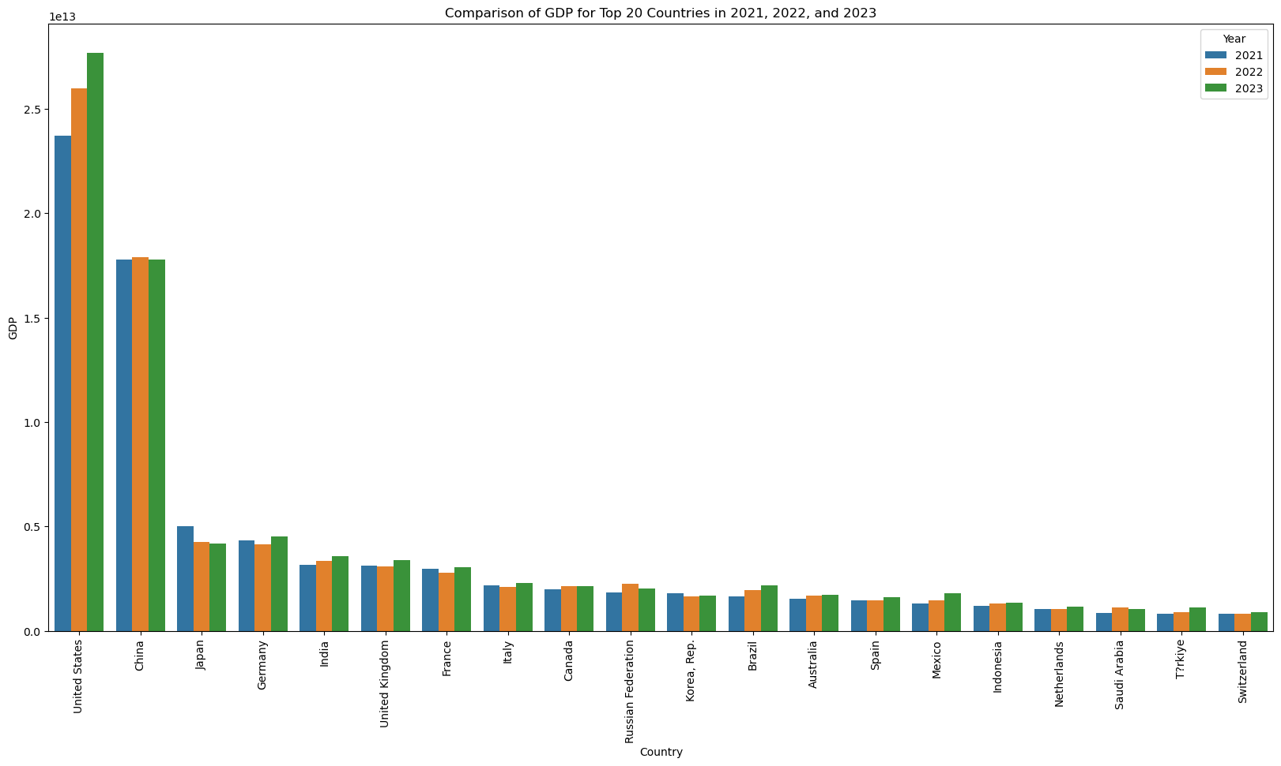
Notes:
How has GDP changed from 2021 to 2023 in the top 20 countries with the highest GDP? As you can observe, the figures have remained relatively consistent.

Slide 12
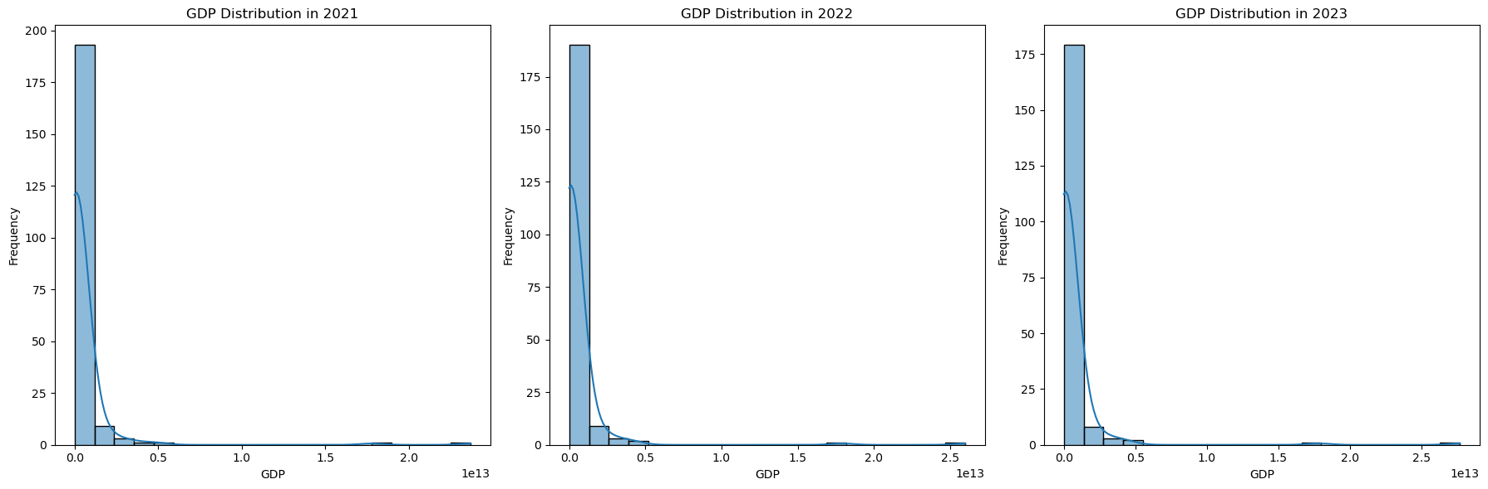
GDP Distribution from 2021 to 2023
Notes:
Also we can observe that, in general, the GDP distribution from 2021 to 2023 has remained relatively consistent.

Slide 13
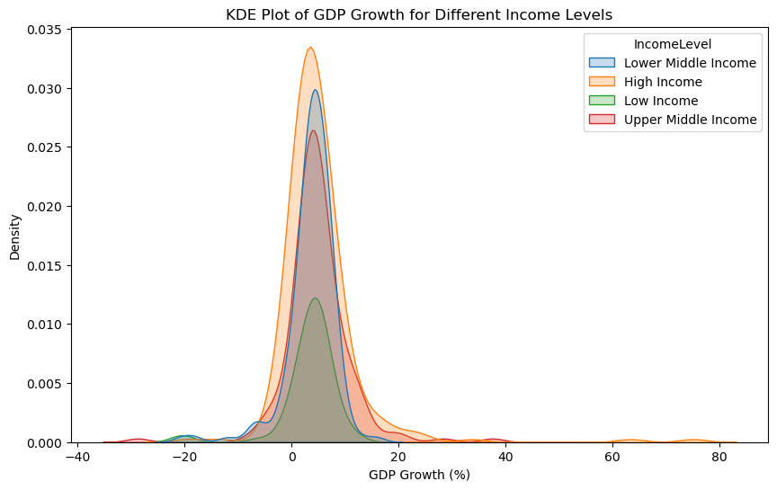
GDP Growth for Different Income Levels
Notes:
The Y-axis or density represents the estimated probability density of GDP growth rates. The higher the curve, the more frequent those GDP growth rates are for a specific income level. As we see here, the GDP growth for countries with higher incomes is likely to be consistently higher.

Slide 14
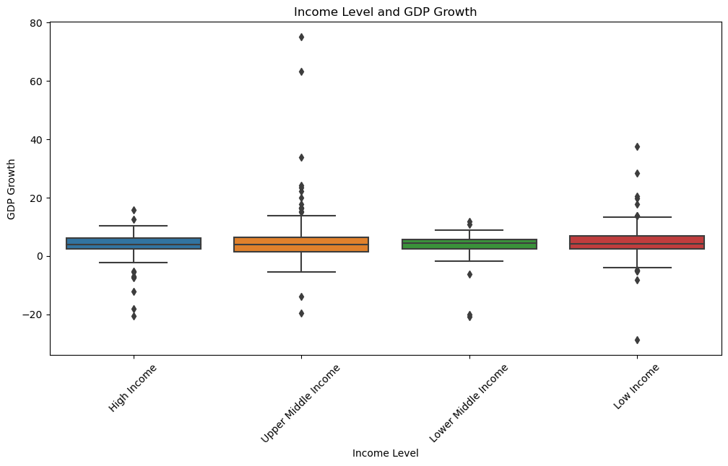
Income Level and GDP Growth
Notes:
The t-test P-value of 0.014 indicates a significant difference between the GDP of high-income countries and that of other countries. However, the t-test with a P-value of 0.092 showed that there is no significant difference in GDP growth rates between high-income countries and other countries

Slide 15
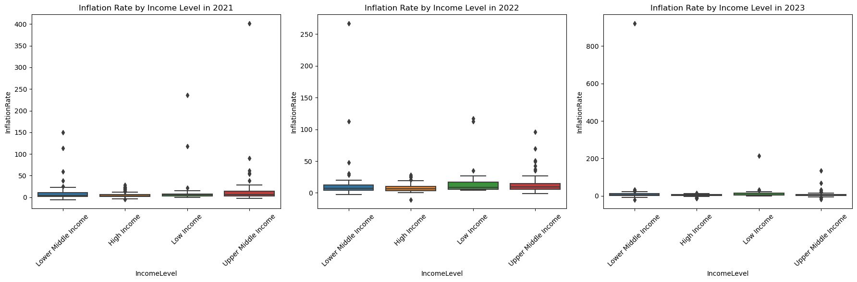
Inflation Rates by Income Levels for 2021 to 2023
Notes:
Have there been differences in the inflation rate for countries with different income levels within the years 2021 to 2023? Based on the chi-square statistic with a p-value of 0.0036, there is a significant relationship between income level and inflation rate.

Slide 16
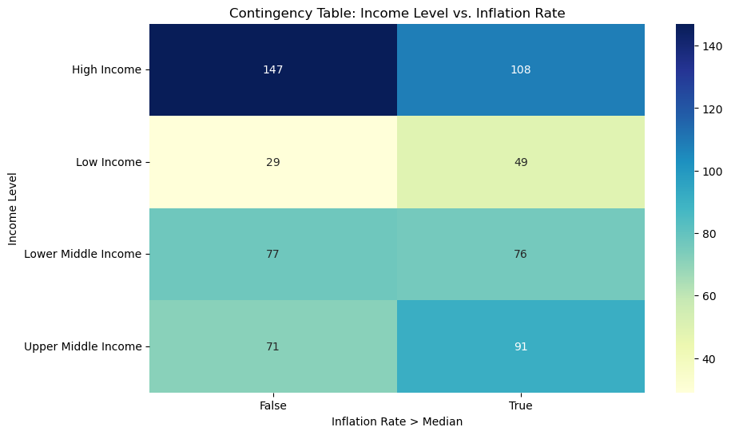
Income Level vs Inflation Rate
Notes:
Based on the chi-square statistic with a p-value of 0.0036, there is a significant relationship between income level and inflation rate.

Slide 17
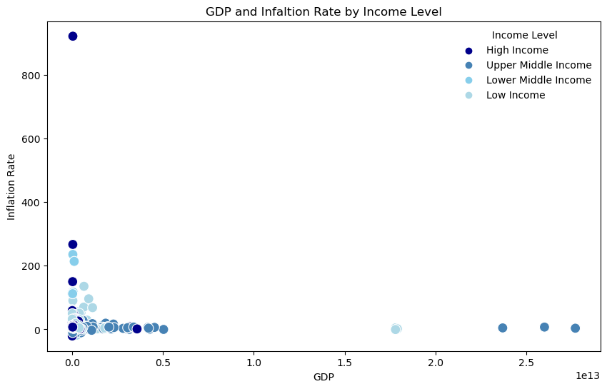
GDP Rate and Inflation Rate by Income Level
High Inflation Rates in Low GDP Countries:
Stable Inflation in High GDP Countries
Clustered Patterns
Inverse Relationship
Notes:
- Countries with lower GDP values (closer to the left of the x-axis) tend to have a wider range of inflation rates, including extremely high inflation rates (e.g., above 200% or even 800%).
- These countries are mostly in the Low Income or Lower Middle Income categories.
- Countries with higher GDP values (closer to the right of the x-axis) generally have lower and more stable inflation rates.
- These countries are predominantly in the High Income category.
- High Income countries are clustered at the bottom-right, indicating high GDP and low inflation.
- Low Income and Lower Middle Income countries are more spread out, with some experiencing extreme inflation rates.
- There seems to be an inverse relationship between GDP and inflation rate: as GDP increases, inflation rates tend to decrease.

Slide 18
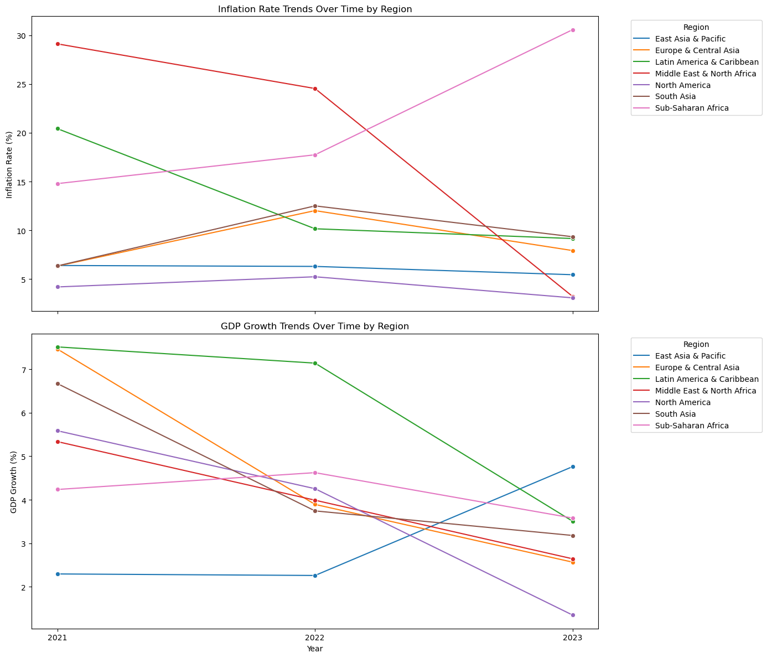
Inflation Rate and GDP from 2021 to 2023
Notes:
We observe that certain regions exhibit distinct behaviors concerning GDP growth and inflation rates. For instance, the inflation rate in Sub-Saharan Africa is increasing, whereas it is decreasing in other regions. Additionally, GDP growth in East Asia and the Pacific remained steady between 2021 and 2022 but experienced a significant increase in 2023.

Slide 19
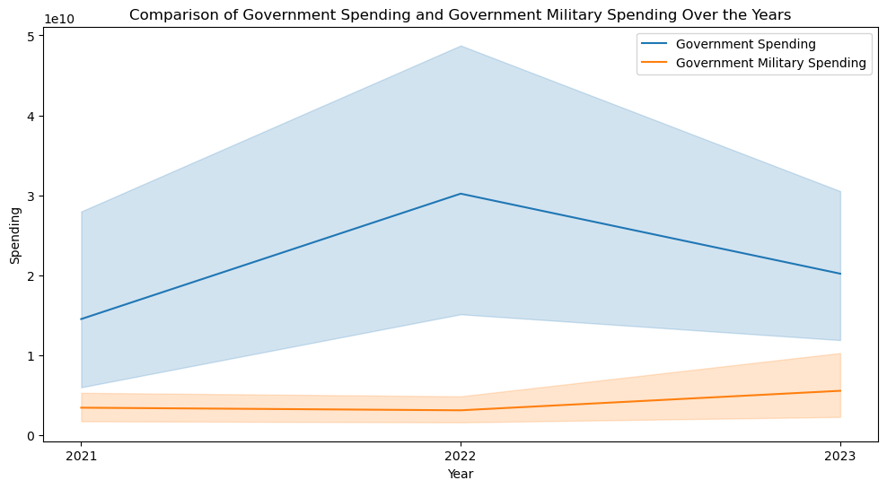
Military Spending
Notes:
When it comes to government expenditure, military spending constitutes a significant portion of the budget.

Slide 20
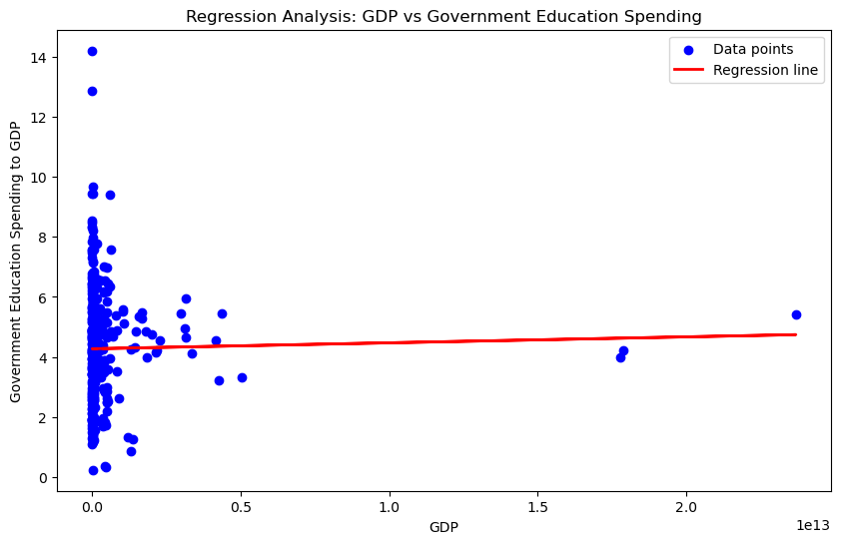
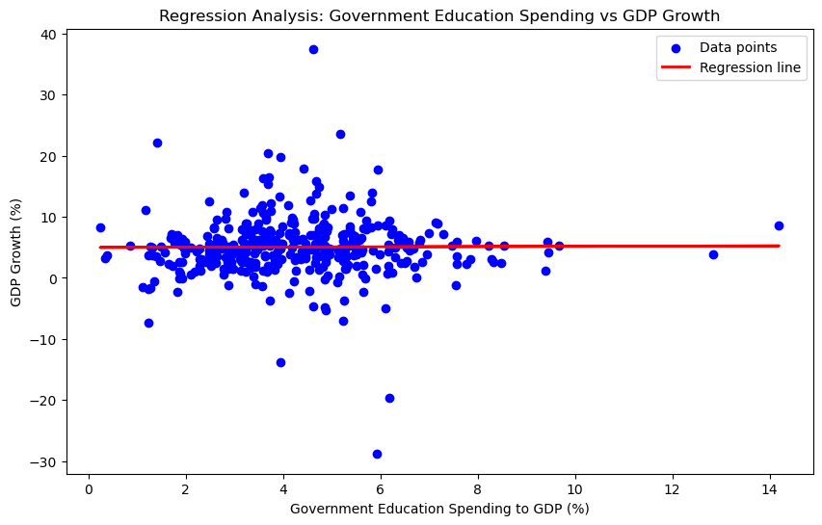
Government Education Spending Impact
Notes:
While military spending constitutes a significant portion of government expenditure, another crucial area to examine is education spending, as it is important to understand how it impacts other economic indicators. Based on linear regression analysis, with a coefficient of 0.0377, an intercept of 4.281, and an R-squared value of 0.0004, there is no linear relationship between GDP and government education spending as a percentage of GDP. Similarly, with a coefficient of 0.035, an intercept of 5.0562, and an R-squared value of 4.759, there is no linear relationship between government education spending as a percentage of GDP and GDP growth.

Slide 21
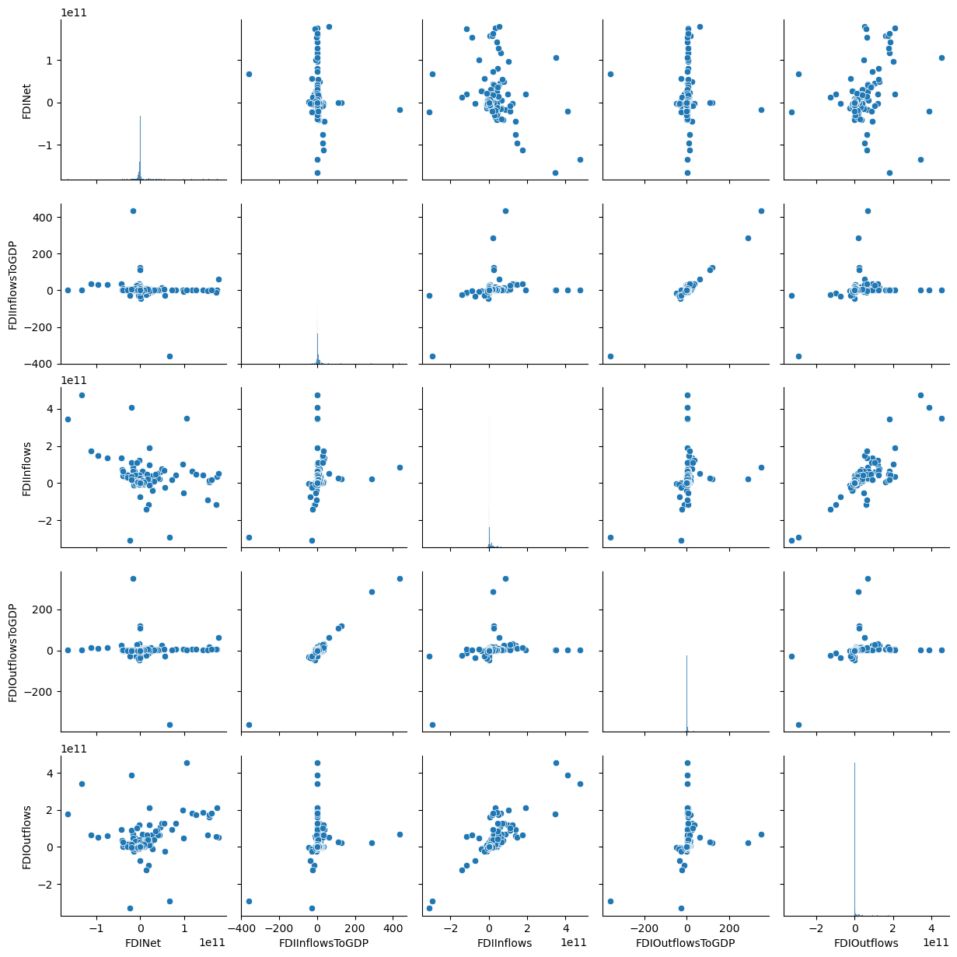
Foreign Investment
Notes:
Another crucial indicator we have is foreign investment. This pair plot examines relationships between six variables related to Foreign Direct Investment: FDI Net, FDI Inflows to GDP, FDI Inflows, FDI Outflows to GDP, and FDI Outflows to GDP. The scatter plots indicate a linear relationship between FDI inflow and FDI outflow.

Slide 22
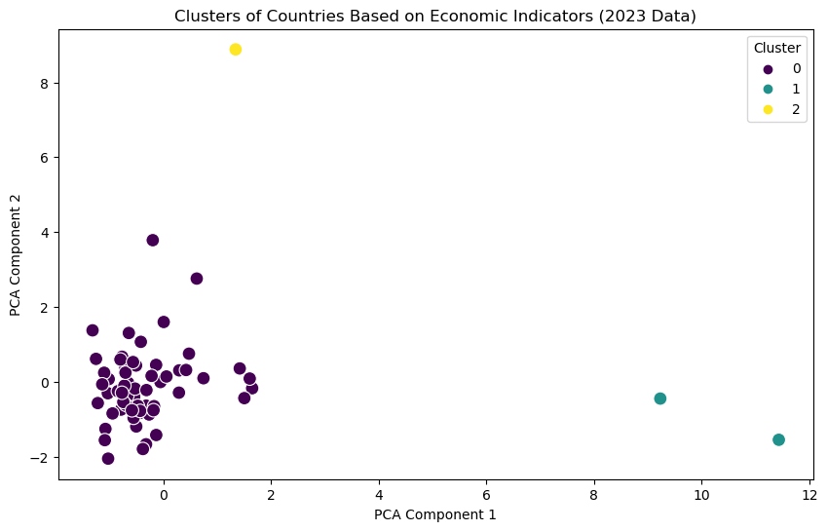
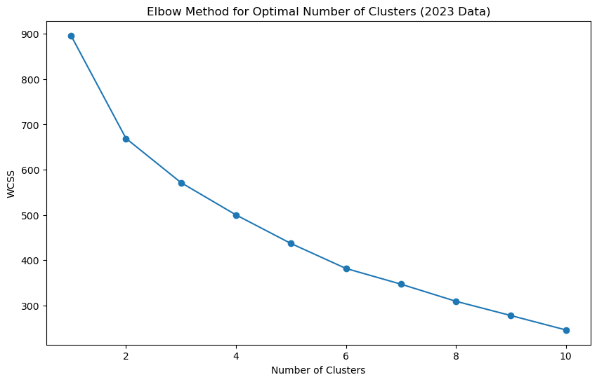
Clustering Countries Based on Economic Indicators
Cluster 0 | Morocco, Andorra, Armenia, Azerbaijan, Bangladesh, Belarus, Belize, Bermuda, Barbados, Bhutan, Côte d'Ivoire, Dominica, Algeria, Ecuador, Fiji, Georgia, Gambia, The, Guatemala, Honduras, Indonesia, Iran, Islamic Rep., Jamaica, Kenya, Kyrgyz Republic, Cambodia, Kuwait, Lao PDR, Sri Lanka, Lesotho, Moldova, Maldives, Mongolia, Mauritania, Mauritius, Malaysia, Namibia, Nepal, Pakistan, Peru, Philippines, Palau, Paraguay, Rwanda, Solomon Islands, Sierra Leone, El Salvador, Suriname, Eswatini, Turks and Caicos Islands, Thailand, Tajikistan, Turkmenistan, Tonga, Tunisia, Tuvalu, Tanzania, Uganda, Uzbekistan, Vanuatu, Samoa, South Africa
Cluster 1 | Hong Kong SAR, China, Singapore
Cluster 2 | Saudi Arabia
Notes:
- The graph shows a sharp decrease in WCSS from 1 to 3 clusters, followed by a more gradual decline.
- Cluster 0 likely represents countries with average or similar economic indicators.
- Cluster 1 may represent countries with unique economic profiles, such as high GDP or specific foreign investment patterns.
- Cluster 2 is an extreme outlier, possibly a country with very distinct economic indicators (e.g., extremely high GDP or unique government spending patterns).

Slide 23
Machine Learning Model Development
Implementation of predictive analytics.
Classifies countries into income categories.
Utilizes different algorithms for analysis.
Focuses on high-income vs non-high-income classification.
Notes:
Having thoroughly explored our data and gained an understanding of their behaviors, it is now time to leverage machine learning to determine if a country has the potential to achieve high-income status based on the economic indicators we have analyzed.

Slide 24
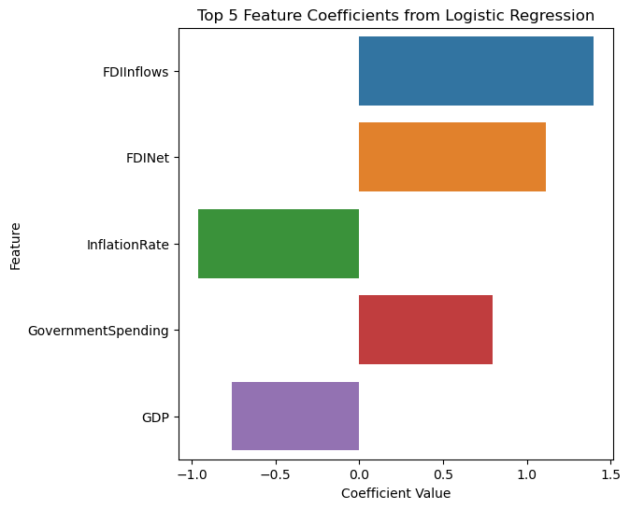
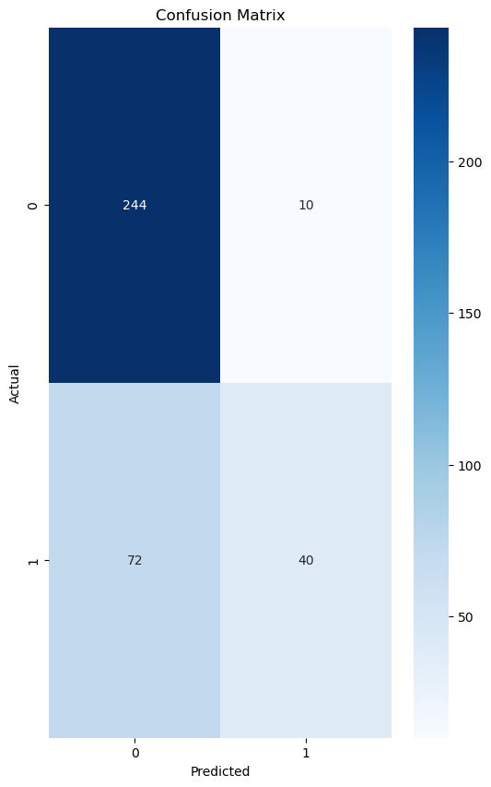
Logistic Regression
Notes:
Logistic regression is a powerful statistical method used for binary classification problems. The first chart highlights the top five feature coefficients, which are crucial for understanding the impact of each feature on the outcome. Notably, FDInflows has the highest positive coefficient, suggesting a strong positive relationship with the target variable, while GDP shows the lowest coefficient, indicating a weaker influence. The second chart, the confusion matrix, is essential for evaluating the model's performance. It provides a clear breakdown of the model's predictions, showing how many instances were correctly or incorrectly classified. This insight is vital for assessing the model's accuracy and making necessary adjustments to improve its predictive power. ______
Accuracy: 0.78

Slide 25
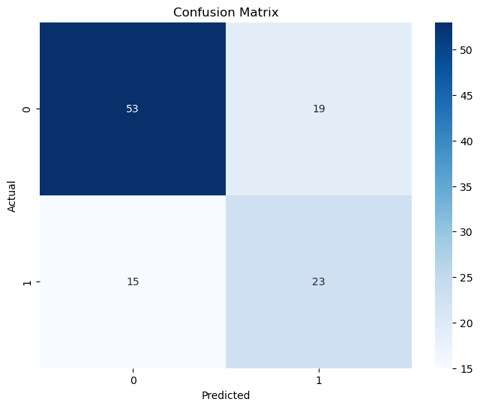
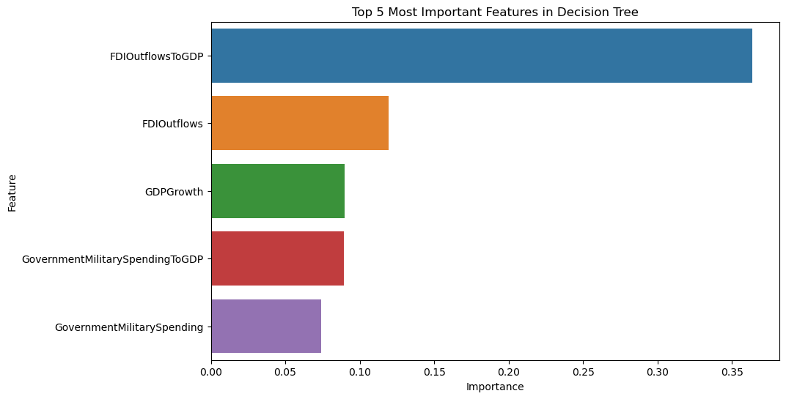
Decision Tree
Notes:
Here we can see Decision Tree model, showcasing two critical visual elements. The horizontal bar chart highlights the top five features that significantly influence the model's predictions, with 'FDI Outflows to GDP' emerging as the most impactful. This insight is crucial for understanding which variables drive decision-making in our analysis. Additionally, the heatmap, representing the confusion matrix, illustrates the model's predictive accuracy by comparing actual outcomes with predicted ones. A high correlation here indicates that our model is performing well, which is essential for building trust in its predictions. Together, these visuals provide a comprehensive overview of the model's effectiveness and the key factors at play. ______
Accuracy: 0.69

Slide 26
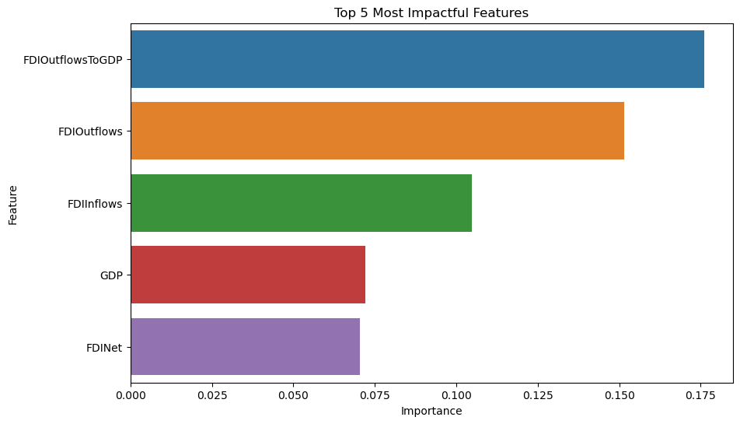
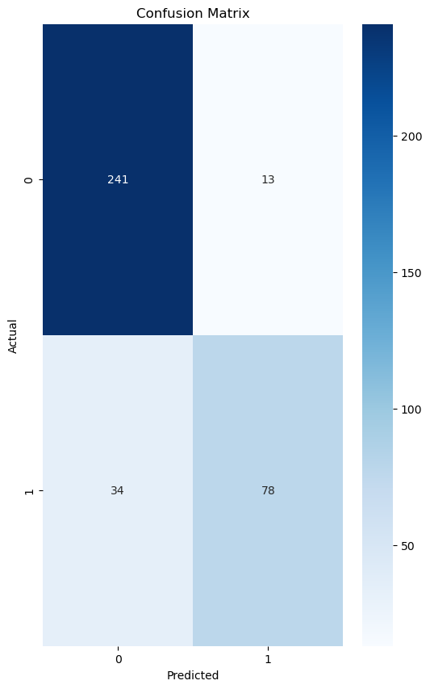
Random Forest
Notes:
This is the results from Random Forest model, focusing on the significance of various features in its predictive power. The bar chart clearly illustrates that 'FDIOutflowsToGDP' is the most influential feature, which suggests that foreign direct investment relative to GDP plays a crucial role in our analysis. Following this, 'FDIoutflows' and 'FDIinflows' also show considerable importance, indicating that both incoming and outgoing investments are vital for understanding the model's outcomes. The confusion matrix provides insight into the model's performance, revealing a strong accuracy with 100 true positives and relatively low false positives and negatives. This suggests that the model is effective in its predictions, which is essential for our strategic decisions. ______
Accuracy: 0.84

Slide 27
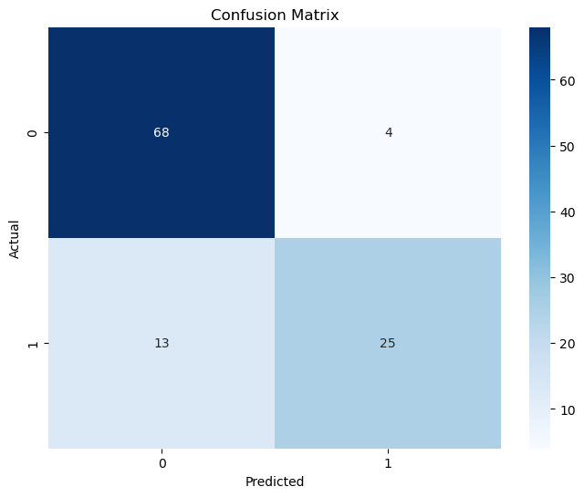
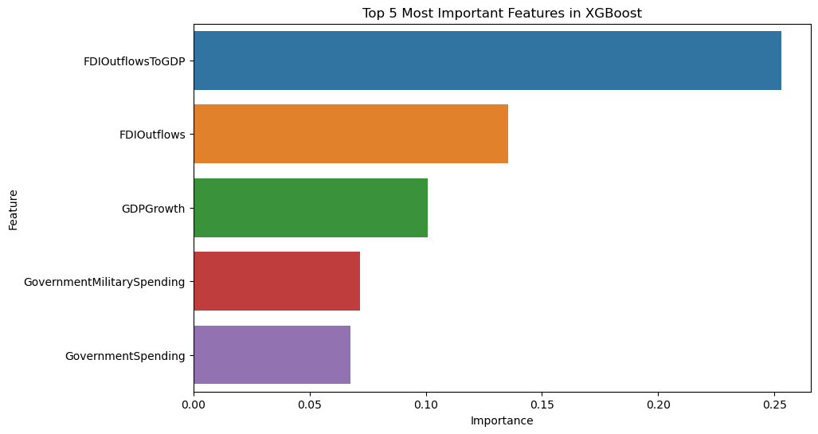
XG Boost
Notes:
XG Boost is a powerful machine learning algorithm known for its efficiency and performance. The bar chart here highlights the top five features that significantly influence the model's predictions. Notably, 'FDI Outflows to GDP' stands out as the most critical feature, indicating its strong correlation with the target variable. In contrast, 'Government Spending' has the least impact, which suggests that it may not be a key driver in this context. The confusion matrix provides insight into the model's accuracy by comparing predicted values against actual outcomes. The highlighted diagonal represents correct predictions, showcasing the model's effectiveness. Understanding these elements is crucial for interpreting the model's behavior and making informed decisions based on its outputs. ______
Accuracy: 0.85

Slide 28
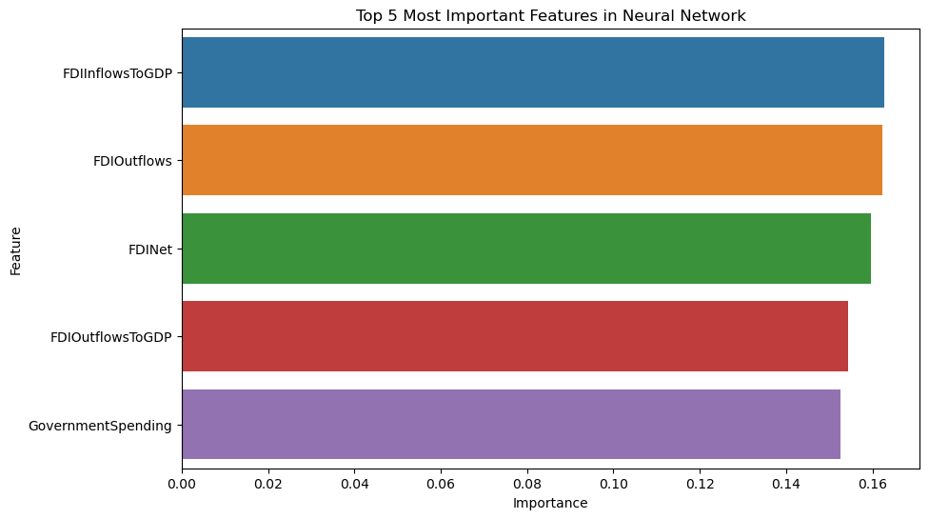
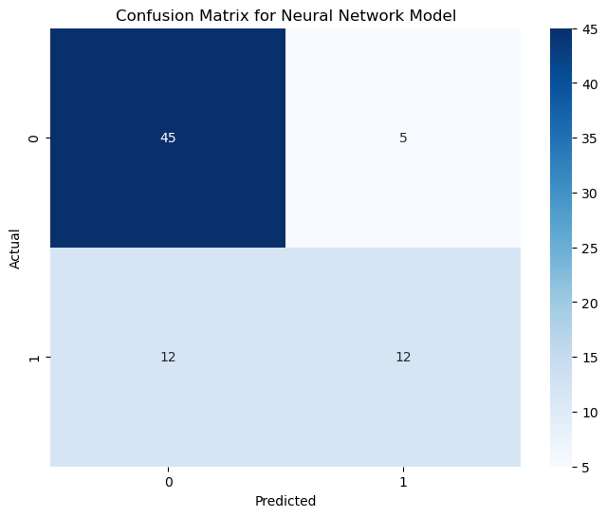
Neural Network
Notes:
Here we see the neural network's performance and the key features that influence its predictions. The bar chart highlights the top five features, with 'FDIinflowsToGDP' standing out as the most significant. This suggests that foreign direct investment relative to GDP plays a crucial role in the model's decision-making process. On the other hand, the confusion matrix provides insight into the model's accuracy, which is currently at 45%. This indicates that there is substantial room for improvement in the model's predictive capabilities. Discussing these elements can help the audience understand both the strengths and weaknesses of the neural network approach in this context. ______
Accuracy: 0.77

Slide 29
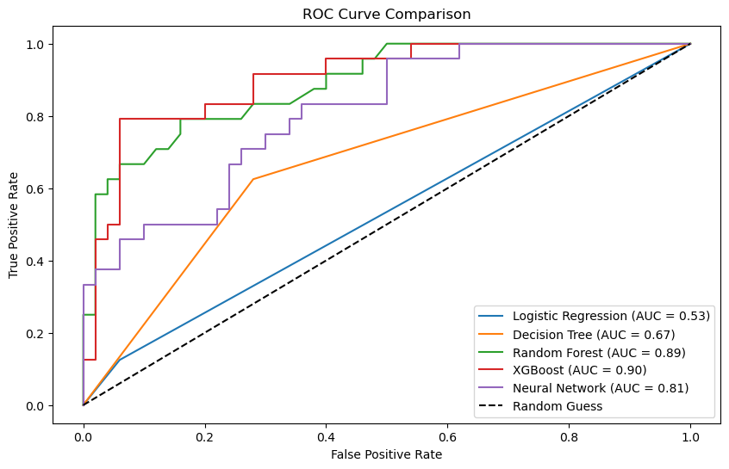
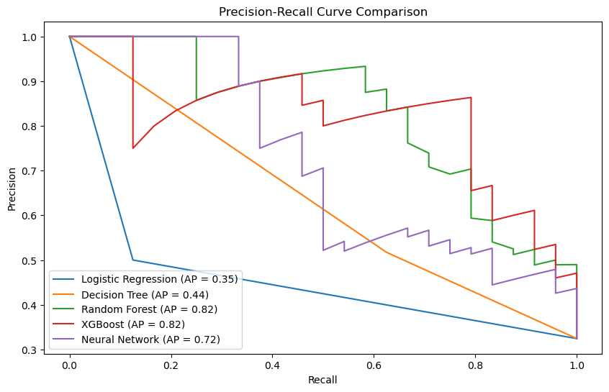
Models Comparison
Model | AUC | Average Precision
Logistic Regression | 0.532 | 0.346
Decision Tree | 0.672 | 0.445
Random Forest | 0.889 | 0.824
XGBoost | 0.903 | 0.817
Neural Network | 0.810 | 0.724
Notes:
- The ROC curve plots the True Positive Rate (TPR) (also called recall) against the False Positive Rate (FPR). It is used to evaluate how well a binary classification model distinguishes between the positive and negative classes. The ROC curve helps to analyze the trade-off between sensitivity (recall) and specificity. Specificity measures the proportion of actual negatives that are correctly identified. Mathematically, it is: Specificity = TN / (TN + FP).
- The precision-recall curve is another graphical tool to evaluate a classification model. It plots Precision (the proportion of true positive predictions out of all positive predictions) against Recall (the proportion of actual positives that are correctly identified) at different threshold values. This curve is particularly useful when dealing with imbalanced datasets, where one class is much more prevalent than the other. It helps assess the trade-off between precision (avoiding false positives) and recall (capturing true positives).

Slide 30

Feature Research Suggestions
Explore user experience improvements for data visualization.
Investigate advanced predictive analytics techniques.
Analyze the impact of external factors on economic indicators.
Develop comprehensive user guides and documentation.
Gather feedback from stakeholders to refine features.
Notes:
Here are some suggestions for further research that can enhance the existing machine learning models and data analysis techniques discussed. By focusing on user experience, predictive analytics, and stakeholder feedback, we can continuously improve our methodologies and outcomes.

